Slide 1

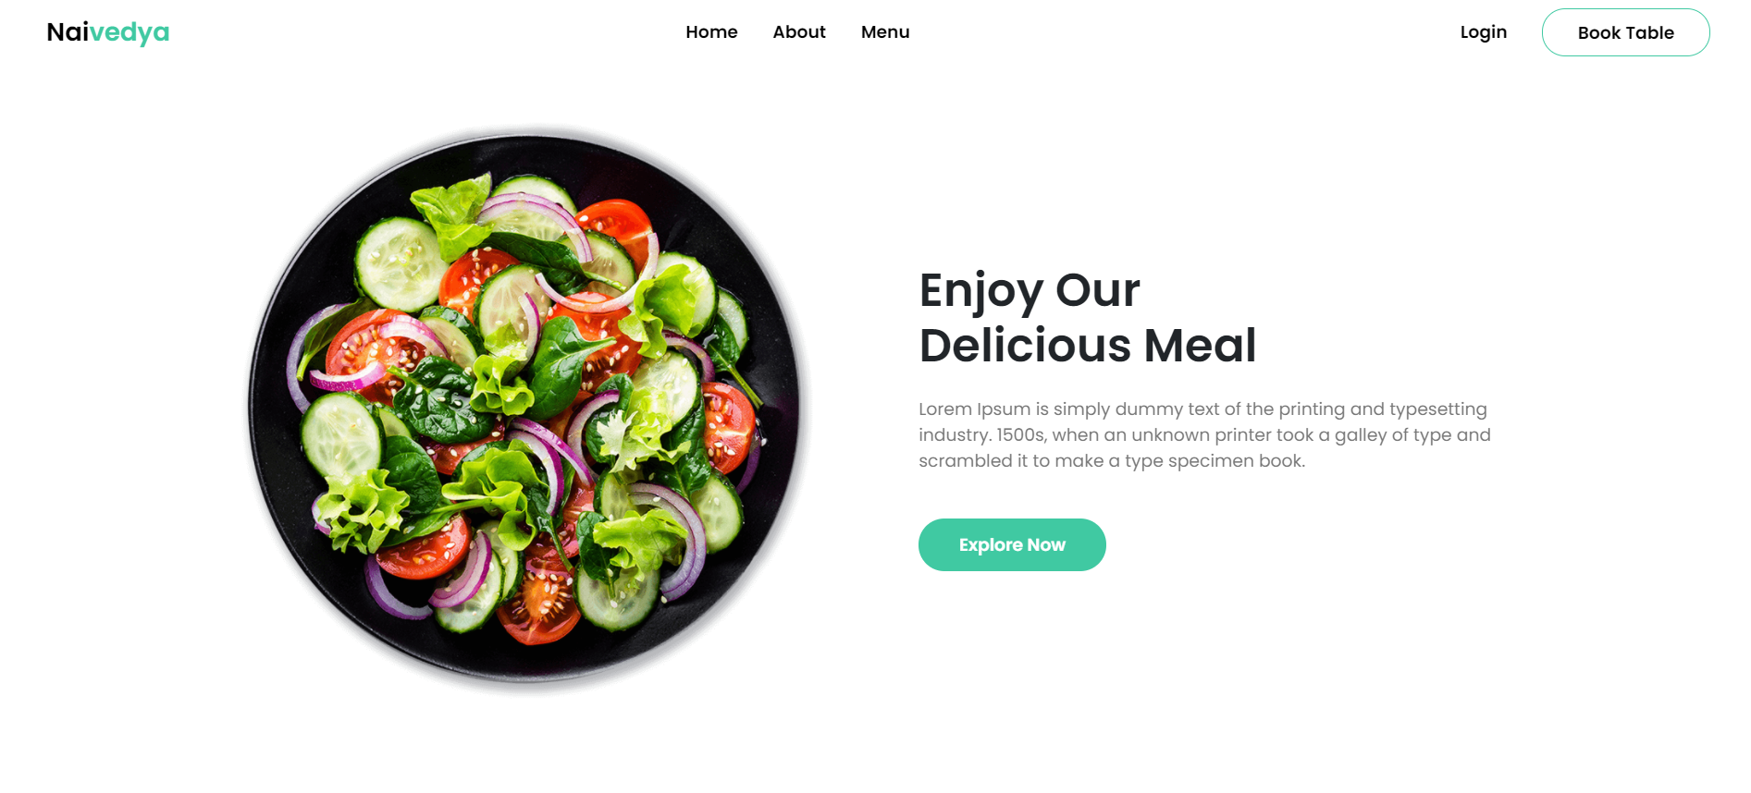

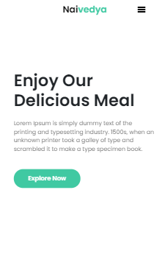
Naivedya
Ankit Jaiswal 191070081
Aryan Khurana 191070008

Slide 2

About Project
Naivedya is a virtual restaurant.We have made a table booking cum online food ordering website. Naivedya means holy or divine offering.We named it our website Naivedya to add an indigenous touch.

Slide 3




Tools Used
Server Side:
Node JS
Express JS
Mongoose
Stripe
Client Side:
HTML, CSS, JS
Handlebars

Slide 4
Website Architecture
Database connection(Mongodb):We have connected our server to mongodb database in index.js using
Mongoose. In order to keep our database secure we have added the mongo uri in config.env file for
Production stage.
Handlebars:We have used handlebars templating engine in order to render our frontend web pages.
APIs:We are using google oauth2.0 strategy in order to authenticate users.We have also used stripe API
In order to enable payments.We make a post request to api from client side.
Routes handle user navigation to various URLs throughout your application. HTTP, short for Hyper Text Transfer Protocol, communicates and facilitates data from our Express server to the web browser.

Slide 5
Flow of the Project
Home
Login
About
Menu
Book Table
Cart
My Orders
Stripe Checkout

Slide 6
Schemas
A database schema is the skeleton structure that represents the logical view of the entire database. It defines how the data is organized and how the relations among them are associated. It formulates all the constraints that are to be applied on the data.

Slide 7
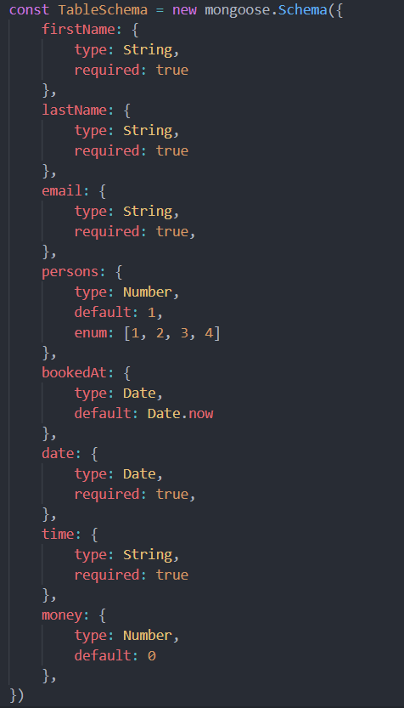
Table Schema
This schema has been used to define attributes that will be required for booking table for user and storing it in suitable database.

Slide 8
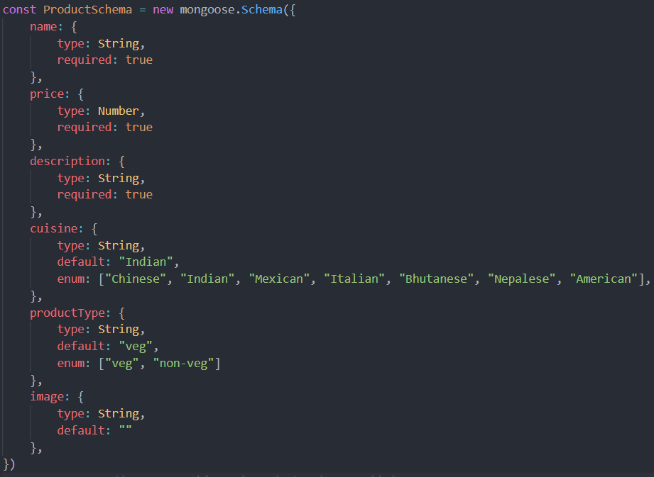
Product Schema
This schema has been used to define attributes for a product that user can buy online and add in their cart.

Slide 9
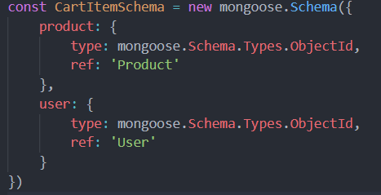
CartItem Schema
This schema has been used to define attributes that will be required for creating cart item that will be stored in database and used for billing.

Slide 10
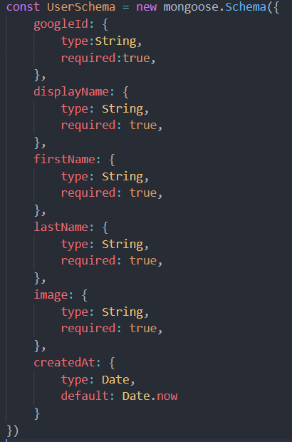
User Schema
This schema has been used to define attributes of user that will be used for authenticating the usage of website.

Slide 11
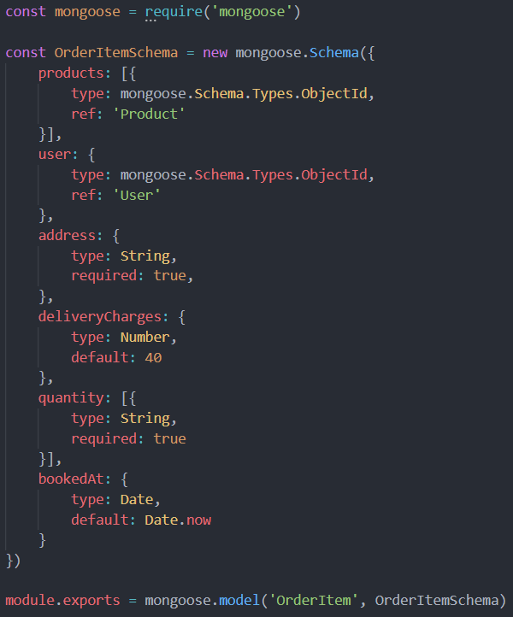
OrderItem Schema
This schema has been used to define attributes that will be required for creating order item that will be stored in database and can be used by the user to check his previous orders.

Slide 12
Details
By default the root route renders the home page for the user.From the home page the navbar
Directs user to other web pages.
If the user wants to book a table the user can go the that page and fill in the details required there and the user is charged 50 Rs. per person for booking a table irrespective of whether the customer turns up or not. The customer can click the book table button to proceed to the payment page. Then the stripe API validates details and makes required payment.
If user wants to order food online,there is a provision of menu that provides a list of all food items.User can appropriately choose items,increase or decrease quantity or even remove items suitable via an interactive UI.There is by default 40 rupees delivery charge.After user is done placing order,stripe API validates payment suitably.

Slide 13
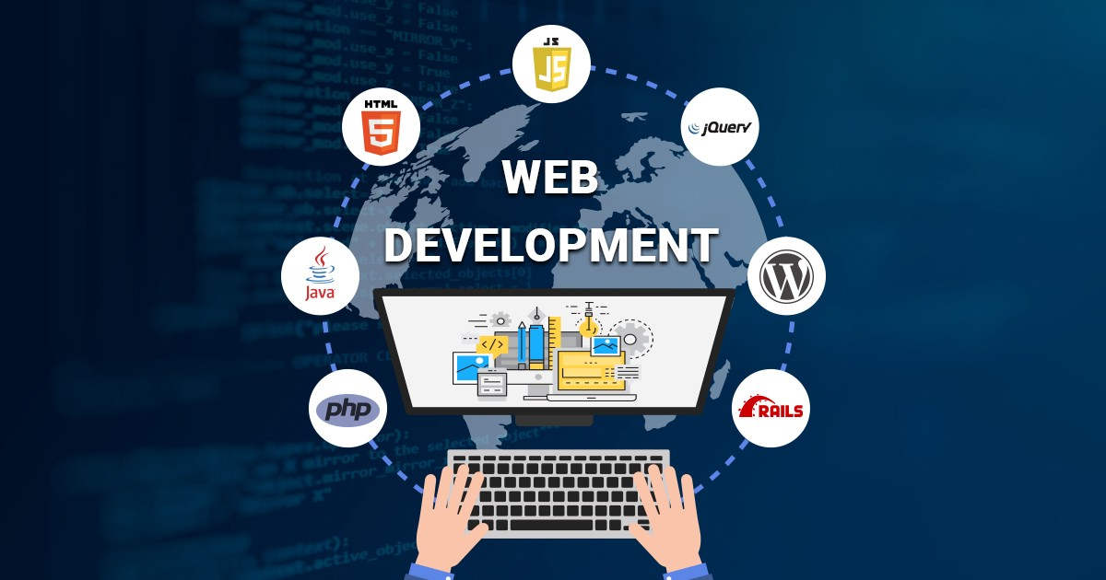
Learning Outcomes
Making responsive and interactive user interface using html,css and javascript.
Using version control systems like git and using github.
Using CSS frameworks like bootstrap and materialise UI.Also learnt jquery.
Server side frameworks such as node js and express js.
Using database frameworks i.e. mongoose to manage unstructured data.
Integrating online card payments using stripe API.
User authentication using passport js.

Slide 14
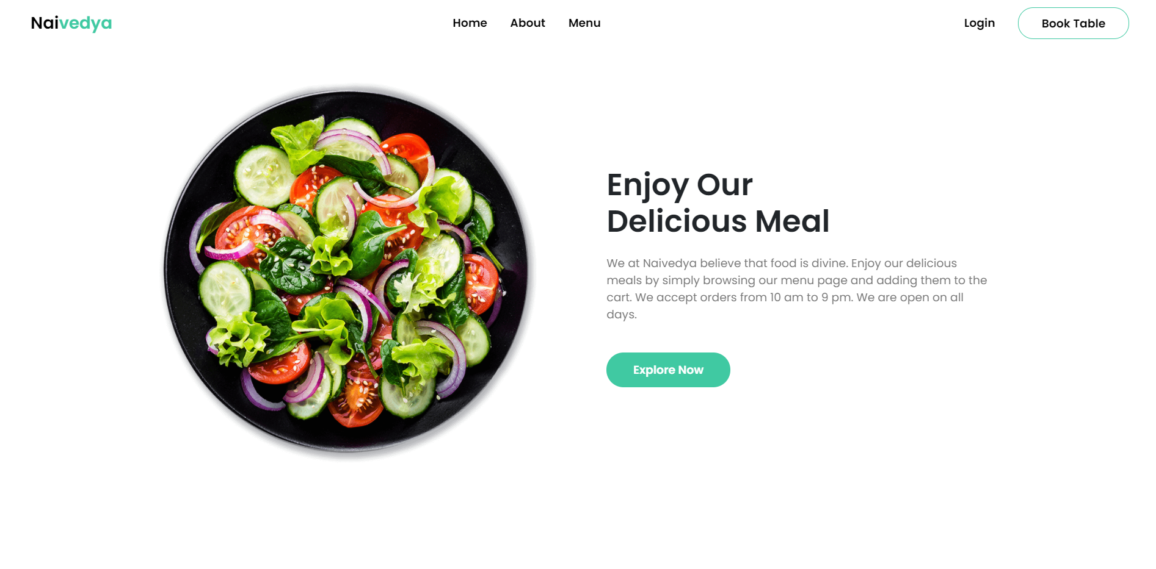
Home Page

Slide 15
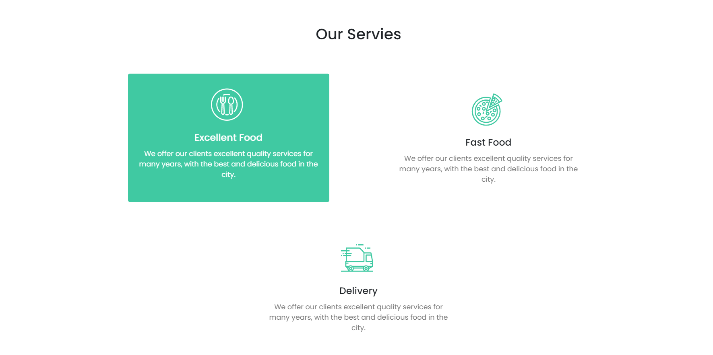
Home Page page

Slide 16
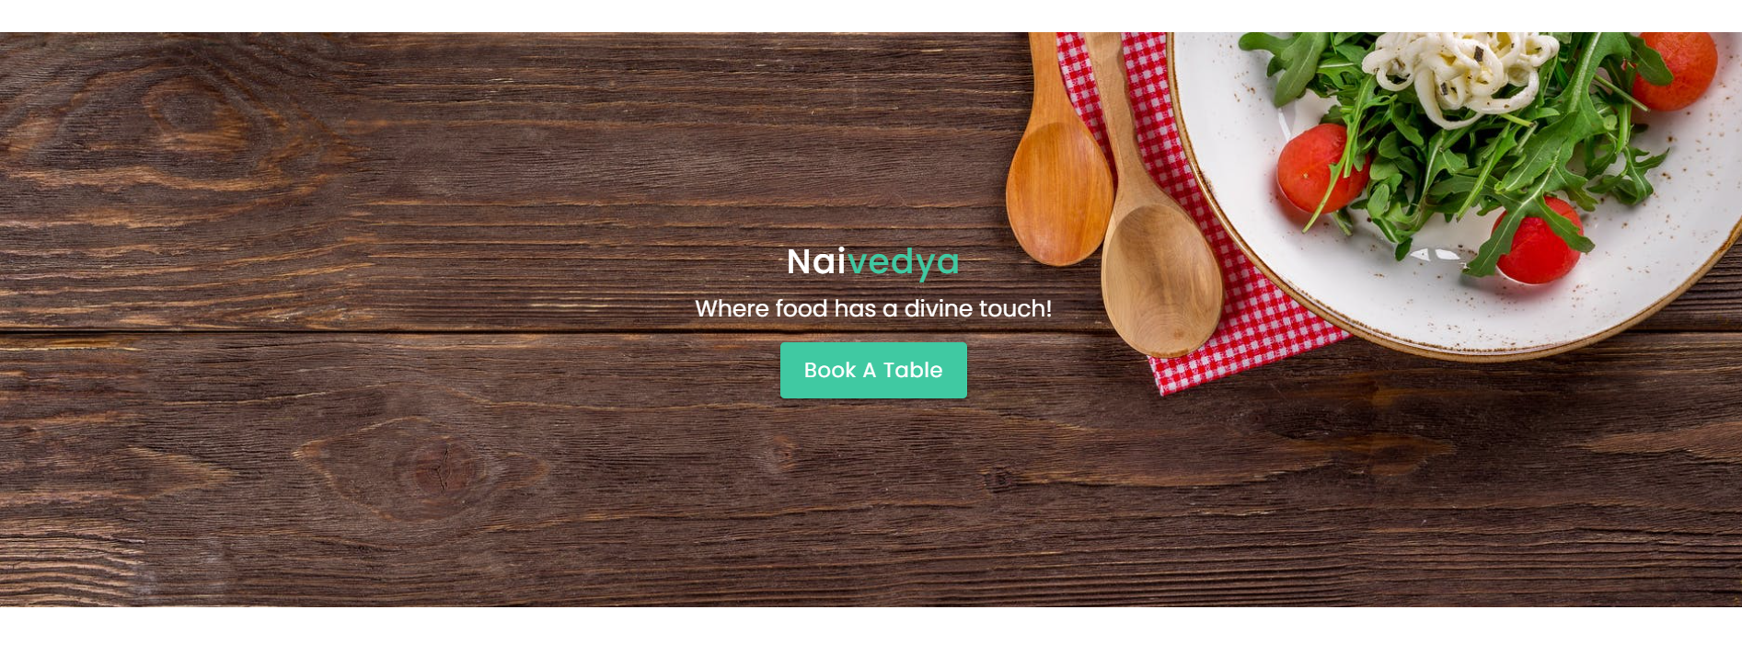
Home Page

Slide 17
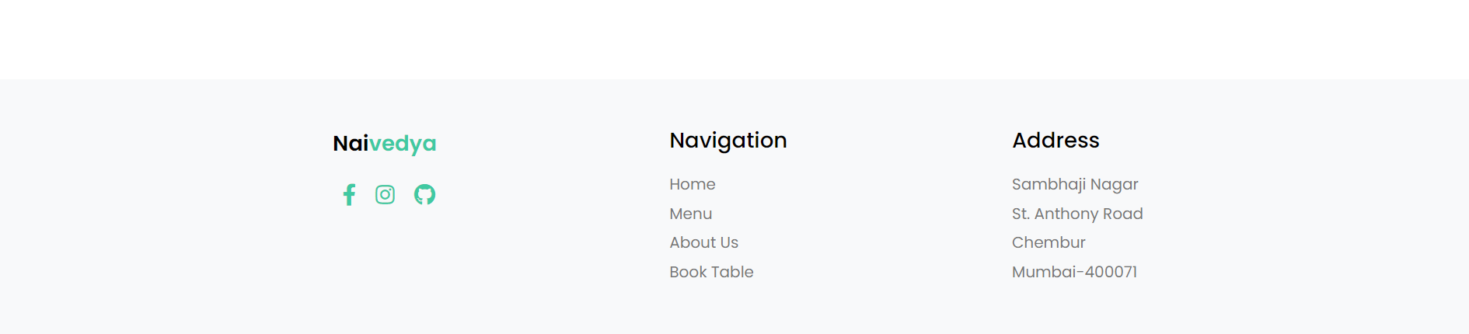
Footer for home page

Slide 18
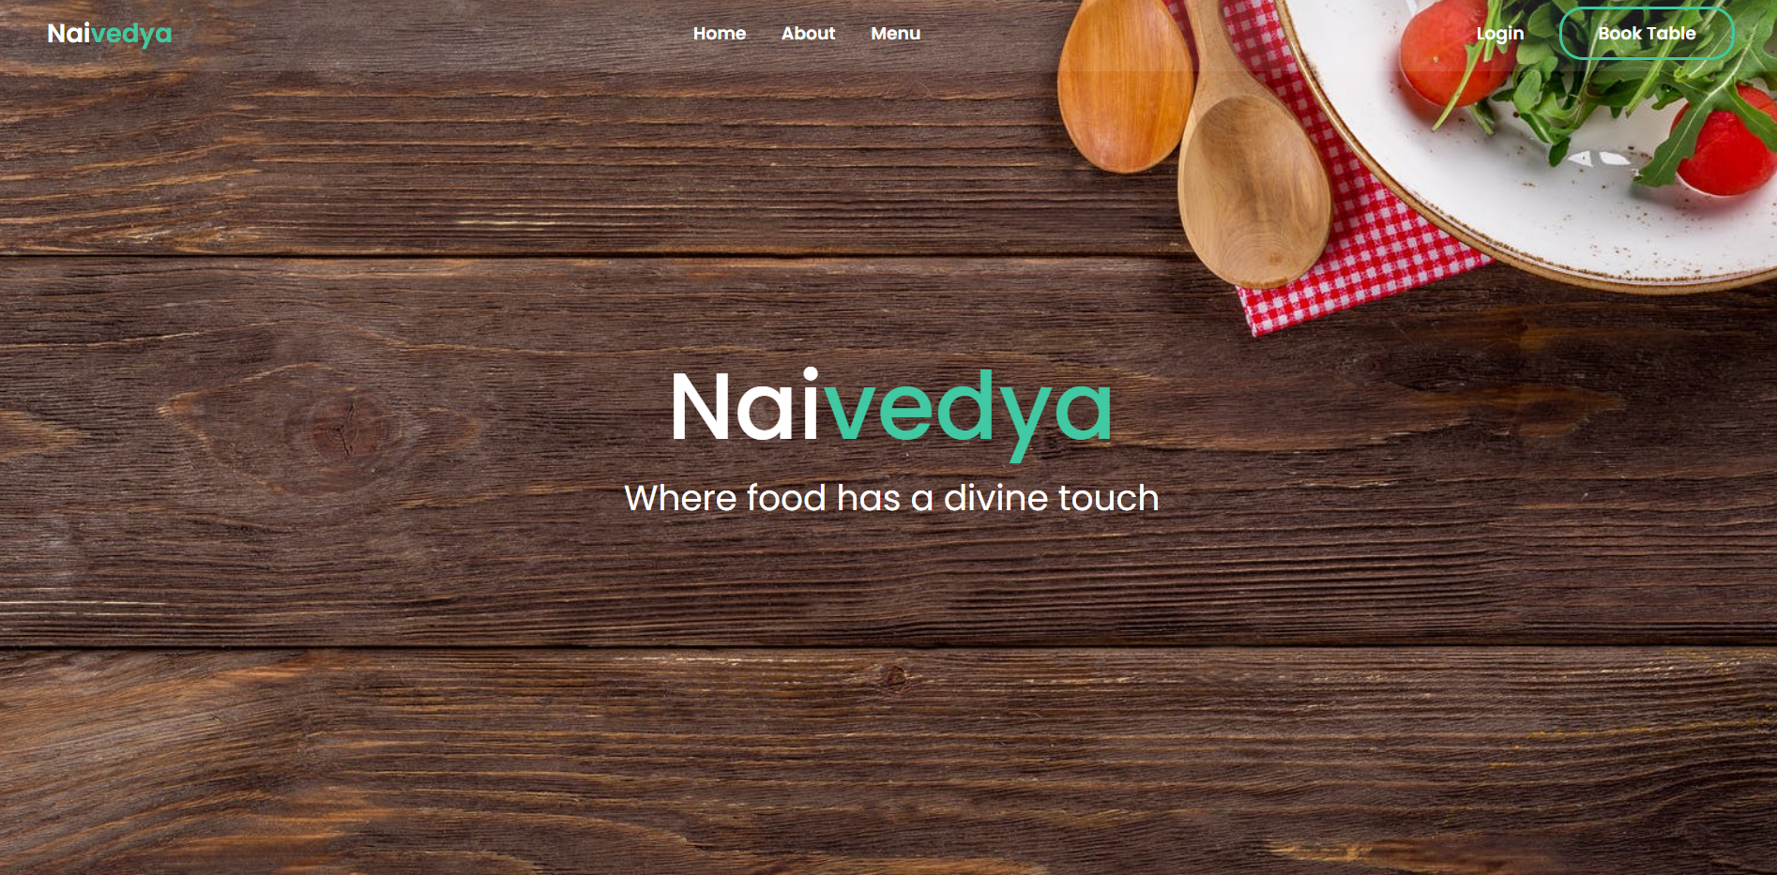
About Us

Slide 19
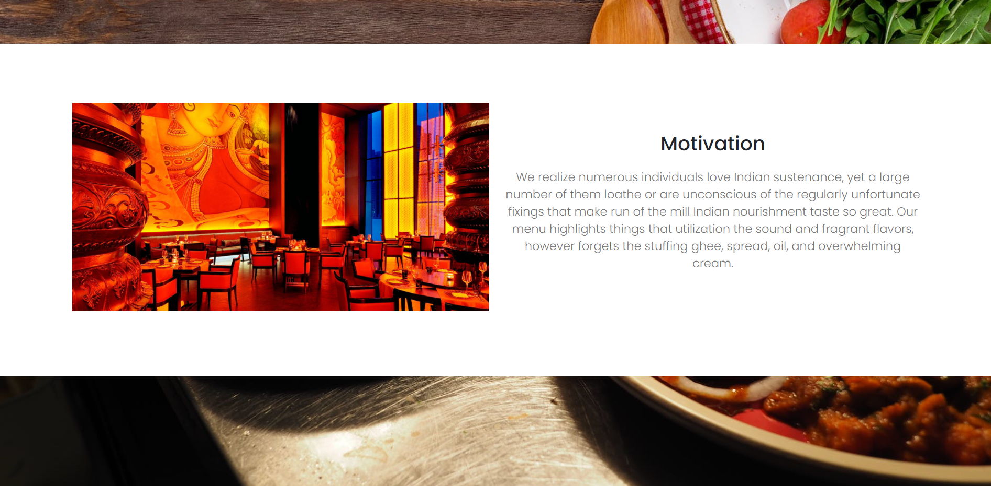
About us

Slide 20
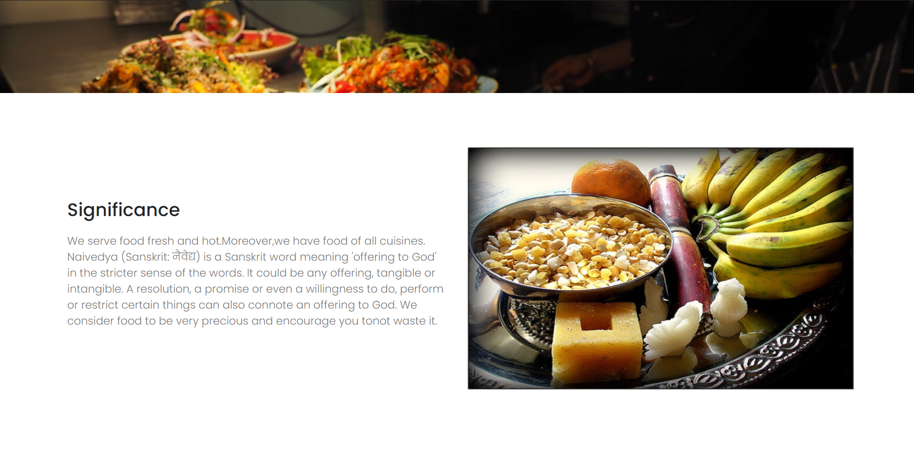
About us

Slide 21
Footer for about us

Slide 22
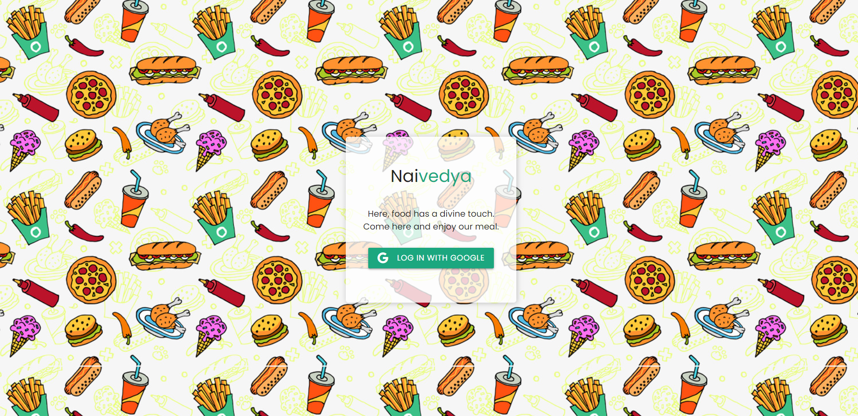
Login

Slide 23
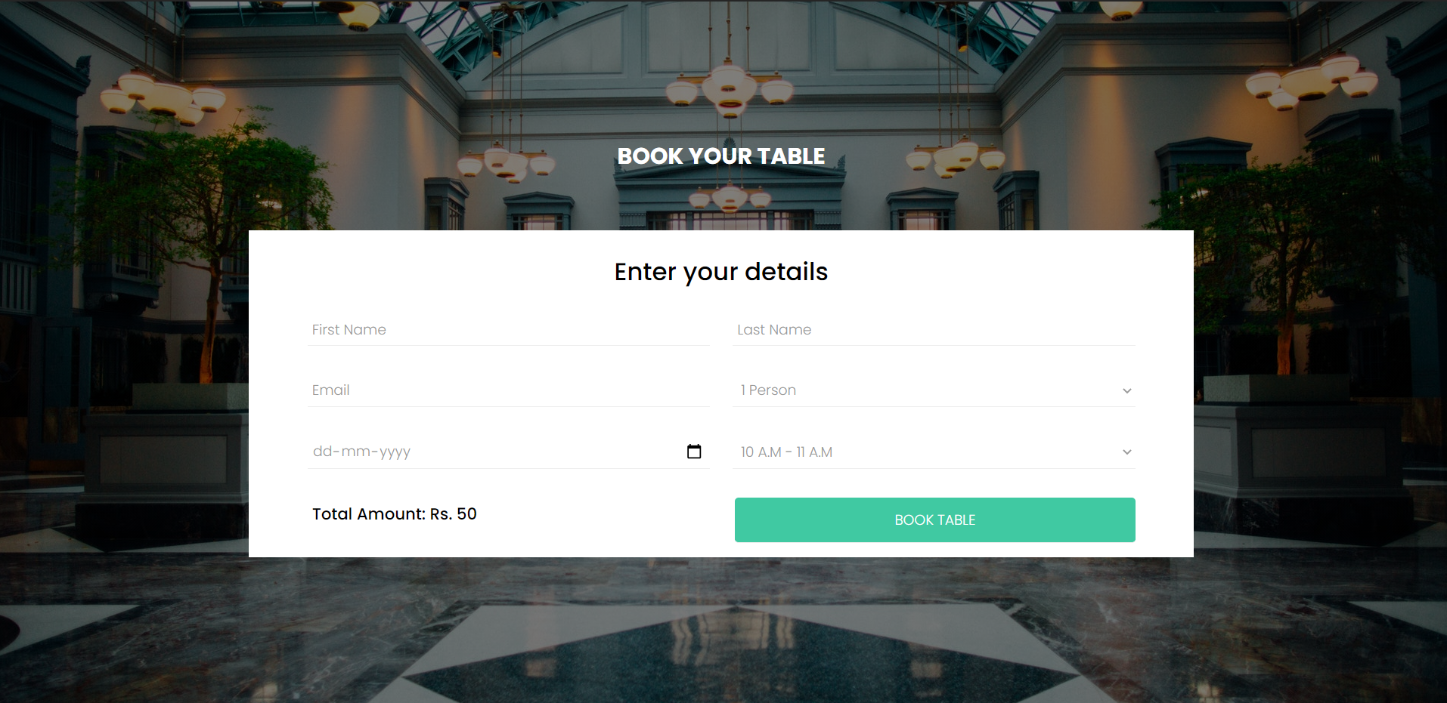
Book a table

Slide 24
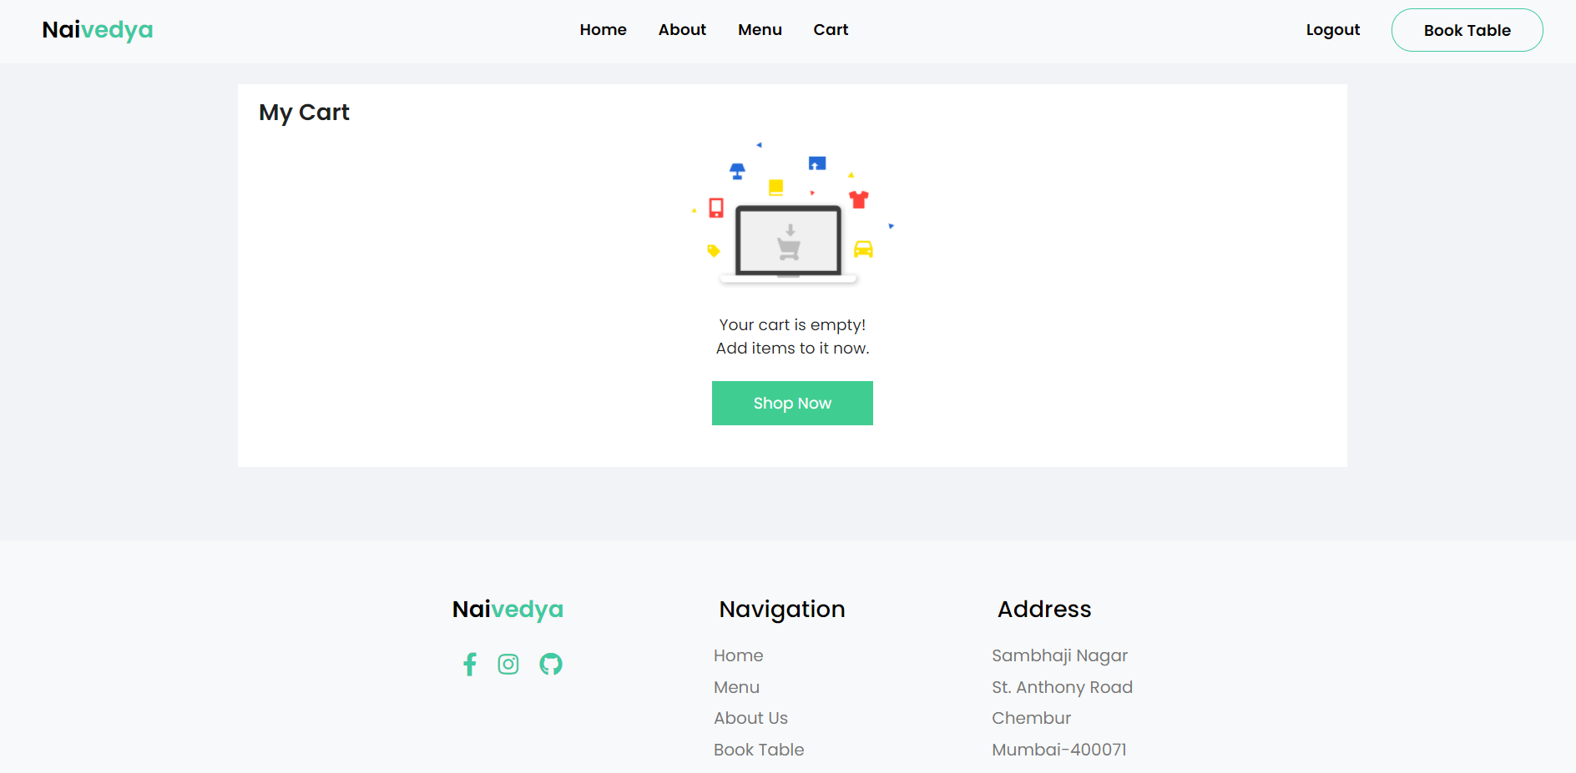
Cart

Slide 25
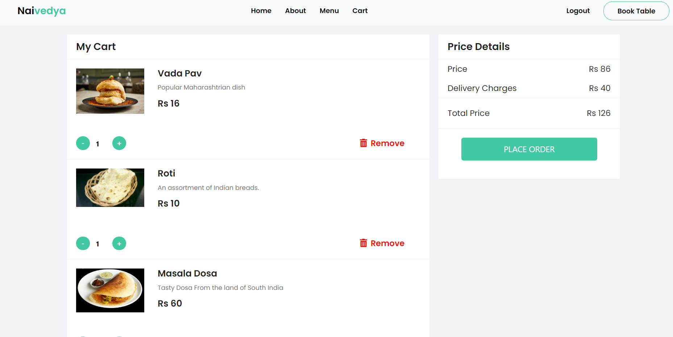
Cart

Slide 26
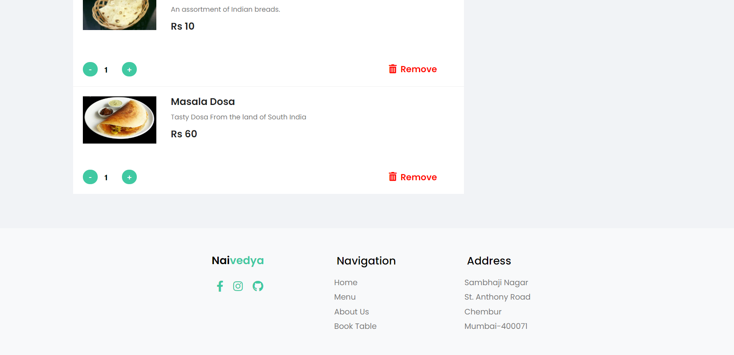
Cart

Slide 27
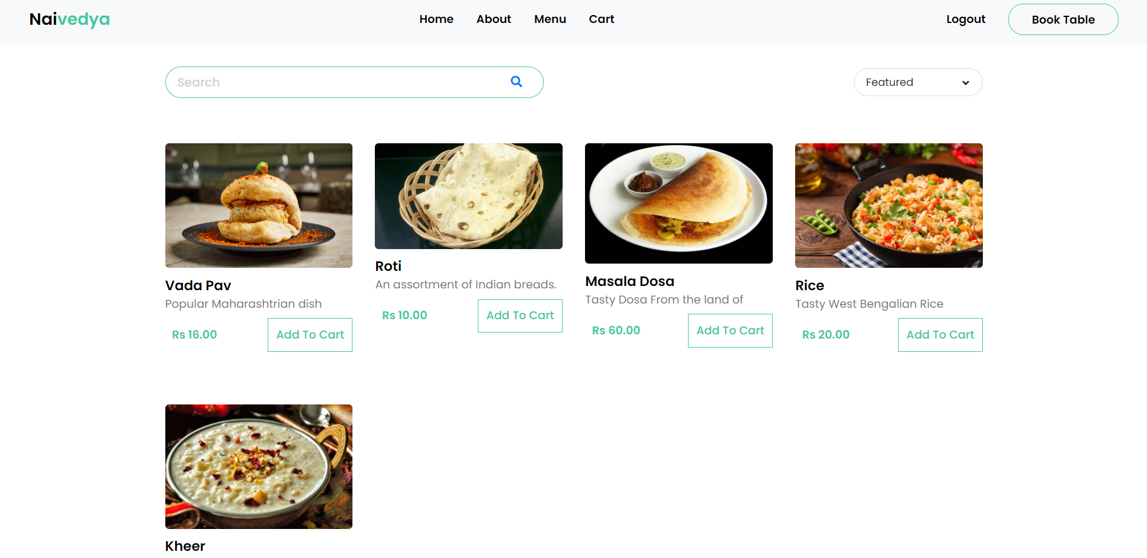
Menu

Slide 28
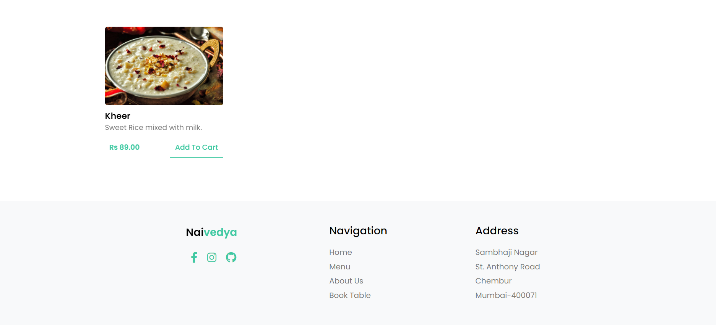
Menu

Slide 29
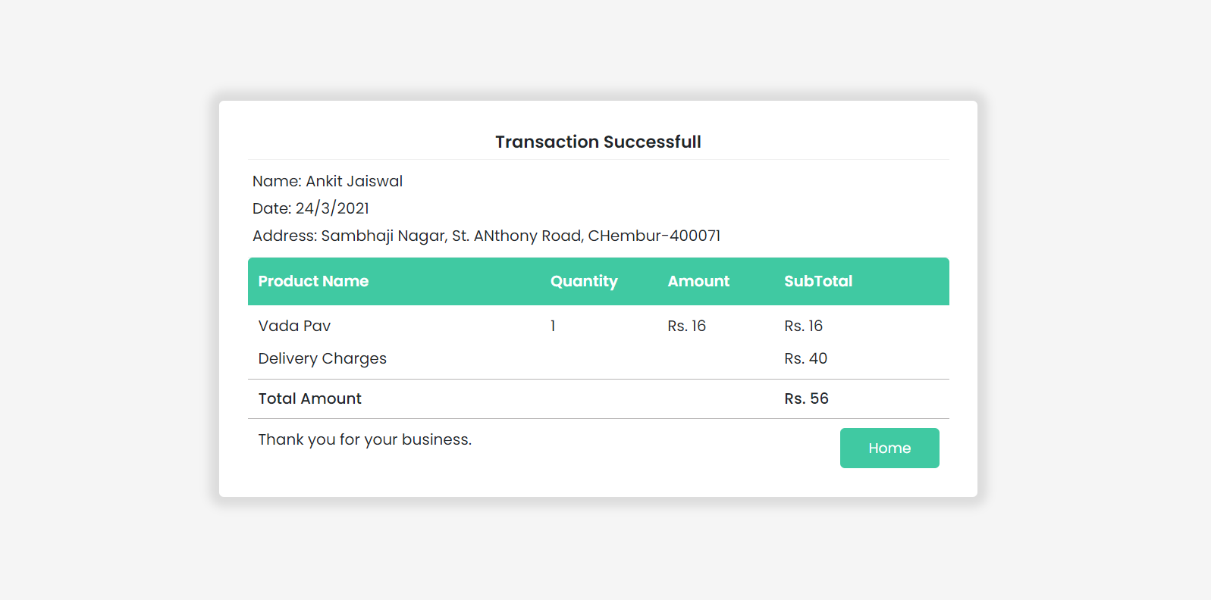
Success

Slide 30
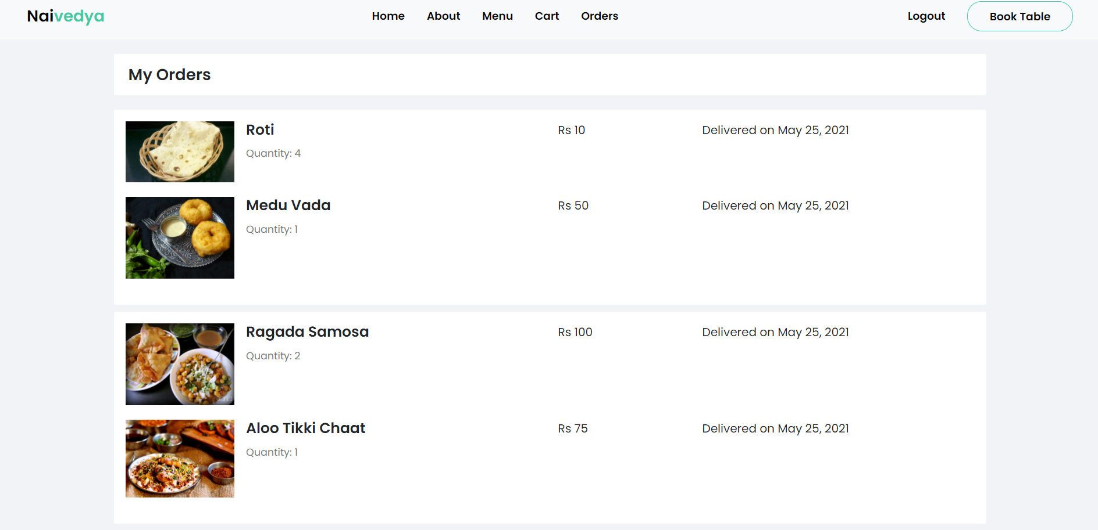
My Orders

Slide 31

Thank You!

